Slide 1


Slide 2
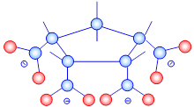

Slide 3
Calcite growth rate reduction by a low-molecular weight, rigid, cyclic polycarboxylic acid
Calcite growth rates were reduced at ppb concentrations of cyclopentane tetracarboxylic acid (CPETCA)
A slow CPETCA adsorption step or CPETCA reorientation cause accelerated calcite-growth rates at low CPETCA concentrations
Calcite growth-rate reduction with increasing CPETCA concentration followed a Langmuir adsorption model from 0 to 50 ppb suggesting adsorbed CPETCA blocks calcite growth sites
Irregular calcite growth steps in the presence of CPETCA supports calcite growth site blockage

Slide 4
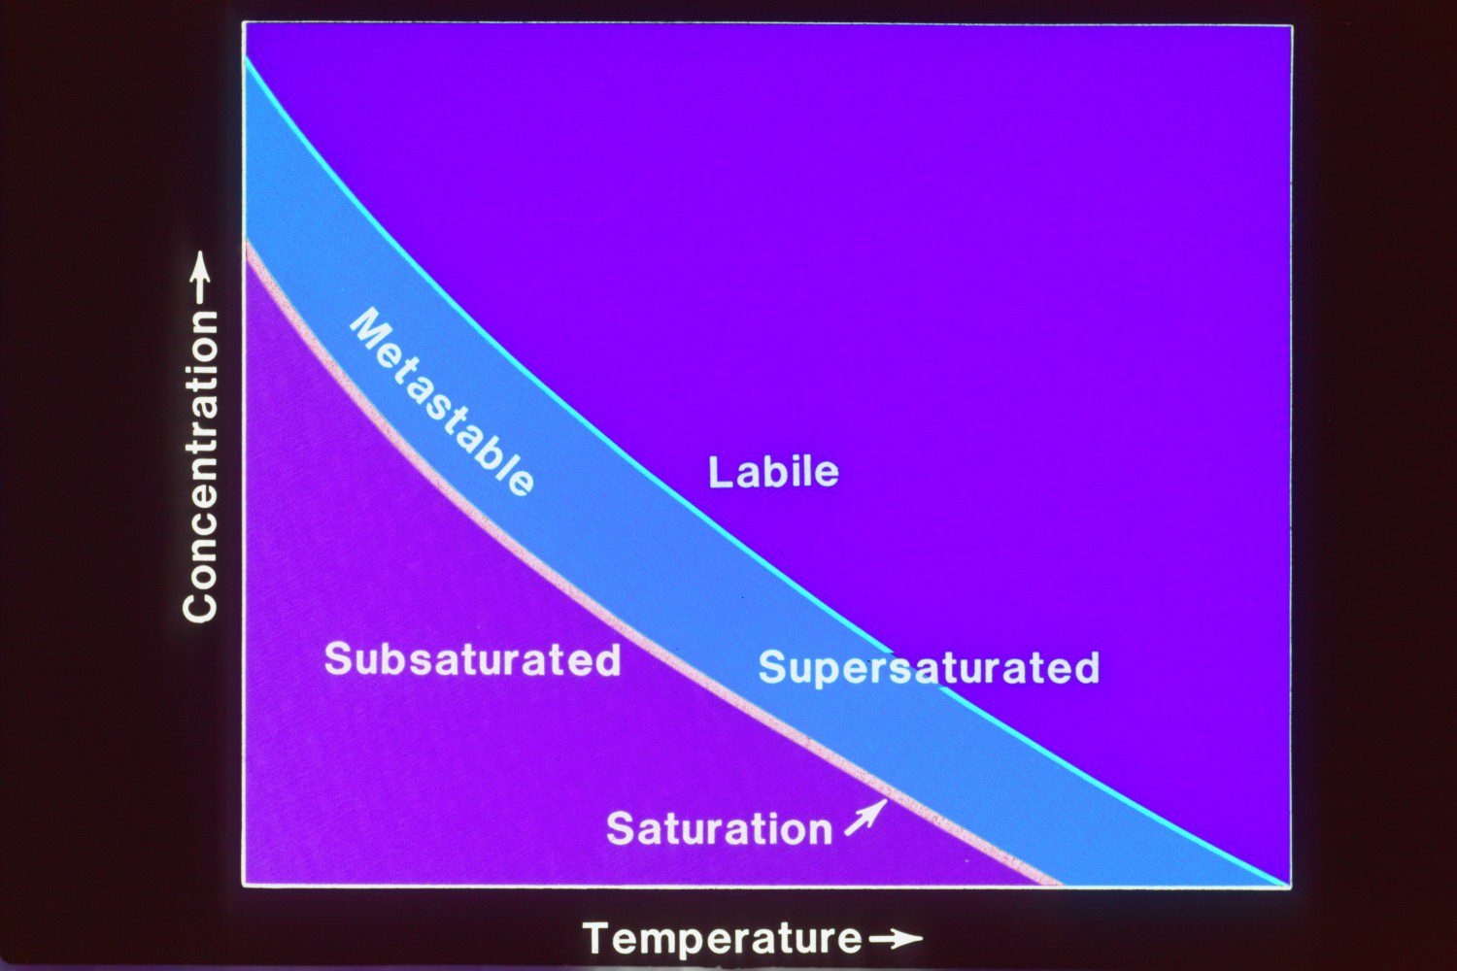
Notes:
Supersaturated solutions are stable for at least 24 hours. PCAs did not initiate calcium carbonate nucleation or growth in the reaction vessel in the absence of added seed crystals

Slide 5
Calcite Saturation State Ω_{c}
Ω_{c} = [Ca²⁺] x [CO₃²⁻]/ K_{sp}calcite
Notes:
Solution Ω_{c} values describe calcium carbonate mineral formation tendency and are defined as:
Ω_{c}= [Ca⁺²][CO₃⁻²]/K_{sp} (1)
where brackets refer to calcium and carbonate ion activities in solution, and K_{sp} is the calcite thermodynamic solubility product at 25º C. Solution speciation and Ω_{c} are calculated with the WATEQ4F program of Ball and Nordstrom

Slide 6
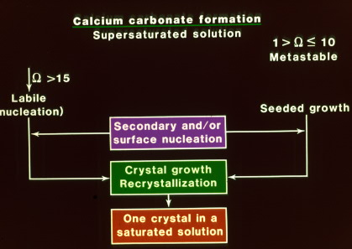
Notes:
CaCO3 formation in supersaturated solution. Left side is spontaneous precipitation at OMEGA Calcite > 15. Today I will discuss calcite formation on calcite seed crystals in a stable supersaturated solution (Omega =5).

Slide 7
Constant Composition Experiment
Calcite Growth
Ca²⁺ + HCO₃⁻ ⬄ CaCO₃ + H⁺
Electrode senses pH drop, system adds equimolar amounts of CaCl₂ and Na₂CO₃ titrant, maintaining constant composition
Notes:
Reliable, reproducible and quantitative method to measure calcium carbonate crystallization rates in laboratory solutions.
Growth creates acidity

Slide 8
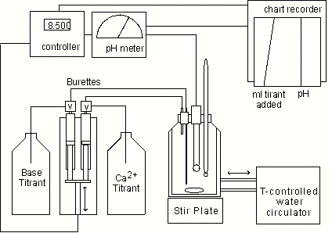
Constant Composition Setup
Notes:
Note primary rate data on chart recorder. Most experiments used a computer interface to automatically record the data. This system is now available commercially as a turn key operation.

Slide 9
Experimental Conditions
25°C
pH 8.5
IAP/K_{sp} (Ωc) = 4.5
I = 0.1 M (KNO₃)
duration = 100 min
seed conc. = 250 mg/L
[CO₃]_{total} = 1.93 mM
[Ca]_{total} = 1.93 mM
[Ca²⁺] = 1.89 mM
P_{CO2} in eq. w/ atmosphere
Stir rate ~ 300 rpm
Notes:
Growth-rate measurement solutions contain total calcium concentration of 0.0019 M, total carbonate concentration of 0.0019 M, pH ~ 8.5, ionic strength of 0.1 M maintained with potassium nitrate background electrolyte, carbon dioxide partial pressure of 10 ^{-3.55} atm, and Ω_{c} of 4.5. Aragonite supersaturation is 3.2, vaterite supersaturation is 1.2, and other calcium carbonate hydrated phases and an amorphous phase are subsaturated in the calcite seeded growth solution. Reproducibility of the crystal growth rates among different experiments is satisfactory. Mean calcite growth rate for two control experiments was 7.055±0.495 (6.6%) in units of moles of calcium carbonate formed per (square meter of seed surface area per minute), (mole/(m²*min))

Slide 11
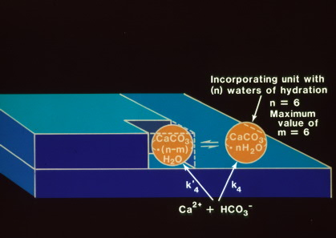
CaCO₃ growth units incorporate at kink sites
Notes:
Calcite growth site showing a CaCO3 hydrated ion pair being incorporated into the calcite crystal lattice by removal of waters of hydration.

Slide 12
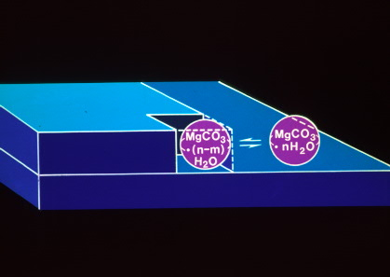
Mg higher dehydration energy reduces rate
Notes:
Magnesium ion (smaller bare ion radius greater hydration and slower dehydration rates) blocking a growth site on the calcite seed crystal surface.

Slide 13
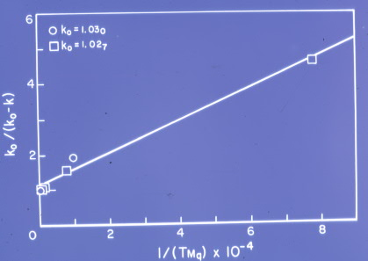
Follows Langmuir adsorption model
Notes:
Linear agreement of magnesium ion inhibition of calcite growth following the Langmuir function.

Slide 14
Langmuir Adsorption Model
R_{o}/(R_{o}-R) = 1 + k₂/(k₁ C_{CPETCA})
R₀ – calcite growth rate in pure solution
k₁, k₂ – CPETCA adsorption/desorption rates
Notes:
The Langmuir Adsorption isotherm used to describe the growth.
The Langmuir adsorption model, used to characterized calcite growth rate inhibition by several compounds assumes calcite growth rate reduction is proportional to the coverage of calcite growth sites by inhibitor molecules. The model also assumes monolayer coverage, that there is a lack of lateral interactions between adsorbed inhibitor molecules at calcite growth sites, and that the crystal growth sites on the calcite surface are energetically equivalent site blockage by magnesium ion.

Slide 16
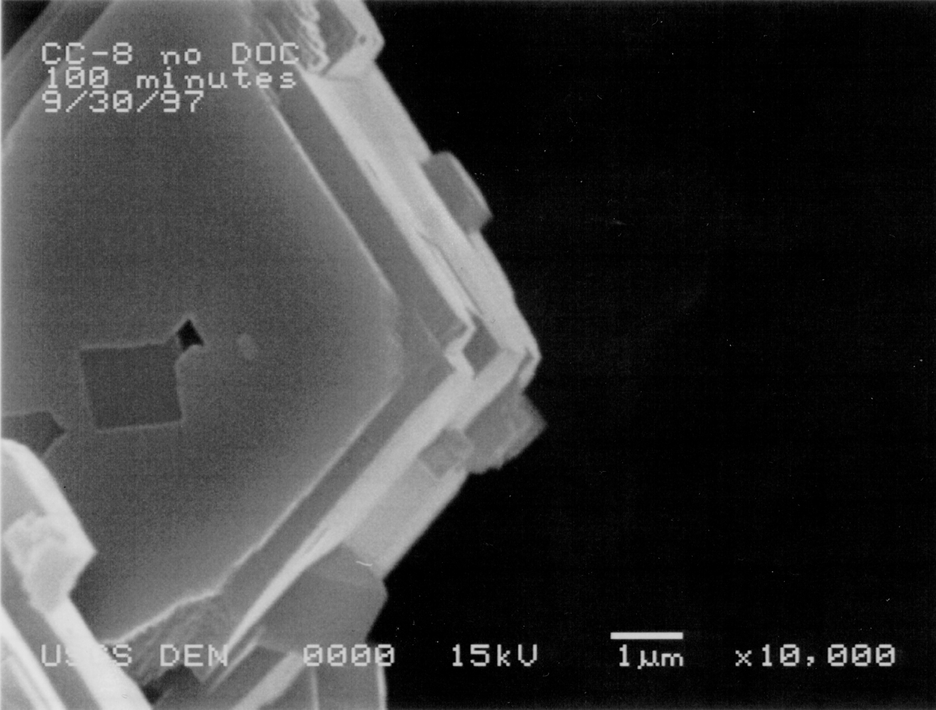
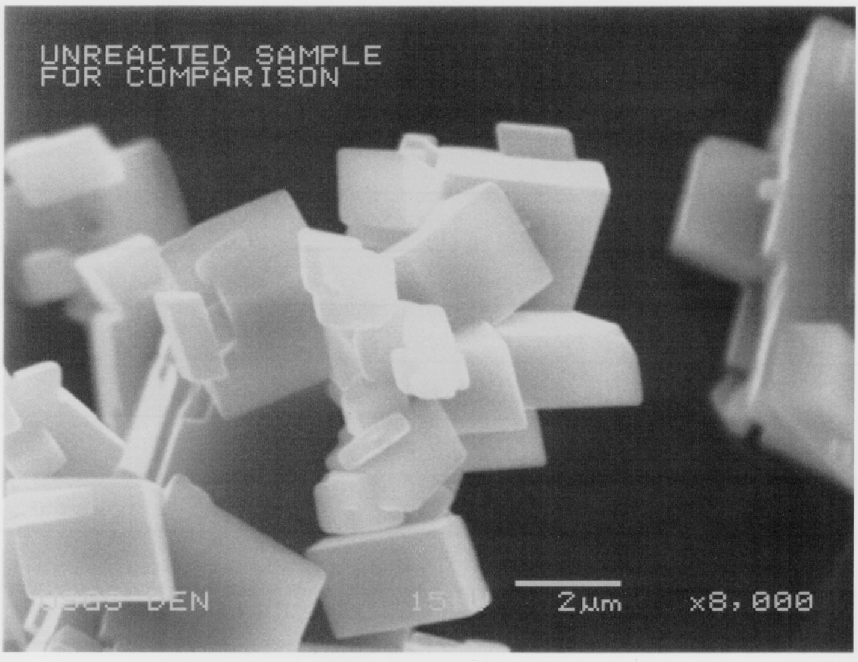
Results:
Morphology with no CPETCA
100 minutes with
no added inhibitor
Unreacted
Notes:
Pictures of results:
Uninhibited, growth occurs in smooth planes on the crystal faces. (25% mass increase). Scanning Electron Microscopy (SEM) demonstrates calcite seed crystal growth morphology differences in the absence and presence of alicyclic five-atom PCAs (Figure 5). Unreacted calcite seed crystals are well-formed, sharp edged rhombs with a mean crystal edge length of 3 micrometers {5844}. Calcite seed crystals size grown for 100 minutes in the absence inhibitors increased mass by about 25% and exhibited uniform growth planes with step features on the growing-face perimeter (Figure 5A). Surface and edge irregularities are almost absent on growth surfaces in the absence of alicyclic five-atom PCAs

Slide 17
10 ppb CPETCA

Slide 18
20 ppb CPETCA

Slide 19
Growth Morphology Differences Support Adsorption Hypothesis
Notes:
}. In the absence of growth rate inhibitors, small growth spirals merge to form straight steps. In the presence of THFTCA and CPETCA adsorption of these solutes reduces the growth rate by blocking the propagation of the uniform growth steps causing a more irregular, discontinuous growth surface (Figure 5B and C) than that observed for growth in the absence of PCA inhibitors (Figure 5A).

Slide 20
Mechanisms of calcite growth rate inhibition by CPETCA
Complexation of Ca²⁺ in solution -- not significant
Inhibitor ion adsorption blocks calcite crystal growth sites
Notes:
1) probably insignificant; complexes only lower supersaturation by a small amount
2) Again, shown by Force microscopy, exact mechanism not known, but people have ascribed it to:
molecular-weight related hydrophobicity, aromaticity related hydrophobicity, preferred stereochemical fit, again could be related to above.
*****************************
Constant composition experiments: how we achieved this...

Slide 21
Acknowledgments
USGS National Research Program

